Slide 1



FPT Software
ANDROID TRAINING
LESSON 8
Version 0.1

Slide 2
Agenda
Persistent Storage
Shared Preferences
Android File API
SQLite

Slide 3
Introduction to Android
Persistent Storage
As mentioned in the Android SDK, there are five different methods:
  Shared Preferences
  Internal Storage
  External Storage
  SQLite Database
  Network

Slide 4
Introduction to Android
Persistent Storage
Shared Preferences
  General framework in Android that will allow you to save/retrieve key value pairs for primitive objects such as boolean, float, int, long and string.
Pros
  Really built-in to the existing Android framework, so easy to use, and easy to create a preference activity to view and edit the preferences
  Quick
  Can really be used to store any data with manipulation with the string type.
Cons
  Not suitable for storing very large amounts of data. As it will be slow in retrieving and sorting through the data.
  Use internal device memory (more limited than external)
  Requires customization for any non-primitive data types.

Slide 5
Introduction to Android
Persistent Storage
Internal Storage
  Uses the devices internal memory to store data in files within the devices internal memory.
Pros
  Many modes of permissions makes this fairly versatile. You can have it usable only by your app, or shared to other applications as read-only or writable.
  Uses the quicker internal device memory
  Can use the cache folder to cache files (that will be removed by Android if it needs space)
  Can be used to store binary files.
Cons
  Uses the space limited internal device memory
  No real built-in framework, so lots of customization necessary.
  Not suitable for retrieving/sorting through large amounts of data.

Slide 6
Introduction to Android
Persistent Storage
External Storage
  Uses the devices external memory (i.e. SD Cards) to store data in files within the devices internal memory.
Pros
  Access to both public shared directories and application specific directory
  Can store binary files
  Space is not an issue with external storage.
  Easy access by the user to backup data to the computer if necessary.
Cons
  Usually, external storage is slower than internal storage
  No real built-in framework, so lots of customization necessary.
  Not suitable for retrieving/sorting through large amounts of data.
  Not reliable as user has access and can modify data/remove the external storage at any time. So also requires more error checking.

Slide 7
Introduction to Android
Persistent Storage
SQLite Database
  Uses the devices internal memory to store data in a SQLite database file.
Pros
  Quick to sort and retrieve large data sets
  Can easily be used to store customized data
  Can enforce relationships and integrity between data
Cons
  Uses space limited internal device memory
  More difficult to setup.
  More difficult and error prone when doing structure changes.

Slide 8
Introduction to Android
Persistent Storage
Network
  Stores the data via web-based services.
Pros
  Easy to share data between devices and computer
  Easy backup of data
Cons
  Not reliable, can’t guarantee network connection
  Most difficult to setup with service and device components
  Uses up data bandwidth(which costs money for users)
  Slowest method as ping rates are usually much much slower than local storage.

Slide 9
SharedPreferences
SharedPreferences are a simple, lightweight key/value pair mechanism for saving primitive application data, most commonly a user's application preferences.

Slide 10
SharedPreferences
How we get access to the preference?
  getPreference() from within Activity:
  to access activity specific preference.
  getSharedPreferences() from within Activity or other application Context:
  to access application-level preference.
  getDefaultSharedPreferences() on PreferencesManager
  to get the shared preferences that work in concert with Android's overall preference framework.

Slide 11
SharedPreferences
Given the appropriate SharedPreferences object:
  Edit(): This object has a set of setters that mirror the getters for the primitive types Boolean, string, float, long, and integer.
  remove(): Deletes a single named preference.
  clear(): Deletes all preferences.
  commit(): Persists our changes made via the editor.

Slide 12
SharedPreferences
We can describe our application's preferences in an XML file stored in project's res/xml/ directory. Android, then, present a UI for manipulating those preferences, which are then stored in the SharedPreferences which we get back from getDefaultSharedPreferences().

Slide 13
Android File API
Access to the file system is performed via the standard java.io classes.
Android provides also helper classes for creating and accessing new files and directories. For example the getDir(String, int) method would create or access a directory. The openFileInput(String s) method would open a file for input and openFileOutput(String s, int) would create a file.
int specifies the permissions which are:
  MODE_PRIVATE - No access for other applications
  MODE_WORLD_READABLE - Read access for other applications
  MODE_WORLD_WRITABLE - Write access for other applications
  MODE_WORLD_READABLE | MODE_WORLD_WRITABLE - Read / Write access

Slide 14
Internal storage
private void writeFileToInternalStorage() {
  String eol = System.getProperty("line.separator");
  BufferedWriter writer = null;
  try {
    writer = new BufferedWriter(new OutputStreamWriter(openFileOutput( "myfile", MODE_WORLD_WRITEABLE)));
    writer.write("This is a test1." + eol);
    writer.write("This is a test2." + eol);
  } catch (Exception e) {
  e.printStackTrace();
  }
  finally {
    if (writer != null) {
      try { writer.close();
      } catch (IOException e) {
        e.printStackTrace();
      }
    }
  }
}

Slide 15
Internal storage
private void readFileFromInternalStorage() {
String eol = System.getProperty("line.separator"); BufferedReader input = null;
try {
  input = new BufferedReader(new InputStreamReader( openFileInput("myfile")));
  String line;
  StringBuffer buffer = new StringBuffer();
  while ((line = input.readLine()) != null) {
    buffer.append(line + eol);
  }
} catch (Exception e) {
  e.printStackTrace();
} finally {
    if (input != null) {
      try { input.close();
      } catch (IOException e) {
      e.printStackTrace();
      }
    }
  }
}

Slide 16
External storage
External storage
  Android supports also access to an external storage system e.g. the SD card. All files and directories on the external storage system are readable for all applications.
  To write to the external storage system your application needs the android.permission.WRITE_EXTERNAL_STORAGE permission. You get the path to the external storage system via the Environment.getExternalStorageDirectory() method.
  Via the following method call you can check the state of the external storage system. If the Android device is connected via USB to a computer, a SD card which might be used for the external storage system is not available.
  Environment.getExternalStorageState().equals(Environment.MEDIA_MOUNTED)

Slide 17
External storage
private void readFileFromSDCard() {
File directory = Environment.getExternalStorageDirectory();
// Assumes that a file article.rss is available on the SD card
File file = new File(directory + "/article.rss");
if (!file.exists()) {
throw new RuntimeException("File not found");
}
Log.e("Testing", "Starting to read");
BufferedReader reader = null;
try {
  reader = new BufferedReader(new FileReader(file));
  StringBuilder builder = new StringBuilder();
  String line;
  while ((line = reader.readLine()) != null) {
    builder.append(line);
  }
  } catch (Exception e) {
    e.printStackTrace();
  }
  finally {
    if (reader != null) {
      try { reader.close();
      } catch (IOException e) {
      e.printStackTrace();
      }
    }
  }
}

Slide 18
SQLite
Android default Database engine is Lite. SQLite is a lightweight transactional database engine that occupies a small amount of disk storage and memory.
Things to consider when dealing with SQLite:
  Data type integrity is not maintained in SQLite, you can put a value of a certain data type in a column of another datatype (put string in an integer and vice versa).
  Referential integrity is not maintained in SQLite, there is no FOREIGN KEY constraints or JOIN statements.
  SQLite Full Unicode support is optional and not installed by default.

Slide 19
SQLite
Creating SQLite Database
  The first step is to create a class that inherits from SQLiteOpenHelper class. This class provides two methods to override to deal with the database:
    onCreate(SQLiteDatabase db): invoked when the database is created, this is where we can create tables and columns to them, create views or triggers.
    onUpgrade(SQLiteDatabse db, int oldVersion, int newVersion): invoked when we make a modification to the database such as altering, dropping , creating new tables.

Slide 20
SQLite
Managing Foreign-Key Constraints
  SQLite 3 by default does not support foreign key constraint, however we can force such a constraint using TRIGGERS

Slide 21
SQLite
Executing SQL Statements
  execute any SQL statement : insert, delete, update or DDL using db.execSQL(String statement)
    db.execSQL("CREATE TABLE "+deptTable+" ("+colDeptID+ " INTEGER PRIMARY KEY , "+ colDeptName+ " TEXT)");

Slide 22
SQLite
Inserting Records
  call this.getWritableDatabase() to open the connection with the database for reading/writing.
  The ContentValues.put has two parameters: Column Name and the value to be inserted.
  close the database after executing statements.

Slide 23
SQLite
Updating Values
  To execute an update statement, we have two ways:
    To execute db.execSQL
    To execute db.update method, the update method has the following parameters:
      String Table: The table to update a value in
      ContentValues cv: The content values object that has the new values
      String where clause: The WHERE clause to specify which record to update
      String[] args: The arguments of the WHERE clause

Slide 24
SQLite
Deleting Rows
  As in update to execute a delete statement, we have two ways:
    To execute db.execSQL
    To execute db.delete method

Slide 25
SQLite
Executing Queries
  To execute queries, there are two methods:
    Execute db.rawQuery method
    Execute db.query method. The db.query has the following parameters:
      String Table Name: The name of the table to run the query against
      String [ ] columns: The projection of the query, i.e., the columns to retrieve
      String WHERE clause: where clause, if none pass null
      String [ ] selection args: The parameters of the WHERE clause
      String Group by: A string specifying group by clause
      String Having: A string specifying HAVING clause
      String Order By by: A string Order By by clause

Slide 26
SQLite
Managing Cursors
  Result sets of queries are returned in Cursor objects. There are some common methods that you will use with cursors:
  boolean moveToNext(): moves the cursor by one record in the result set, returns false if moved past the last row in the result set.
  boolean moveToFirst(): moves the cursor to the first row in the result set, returns false if the result set is empty.
  boolean moveToPosition(int position): moves the cursor to a certain row index within the boolean result set, returns false if the position is un-reachable
  boolean moveToPrevious(): moves the cursor to the previous row in the result set, returns false if the cursor is past the first row.
  boolean moveToLast(): moves the cursor to the lase row in the result set, returns false if the result set is empty.

Slide 27
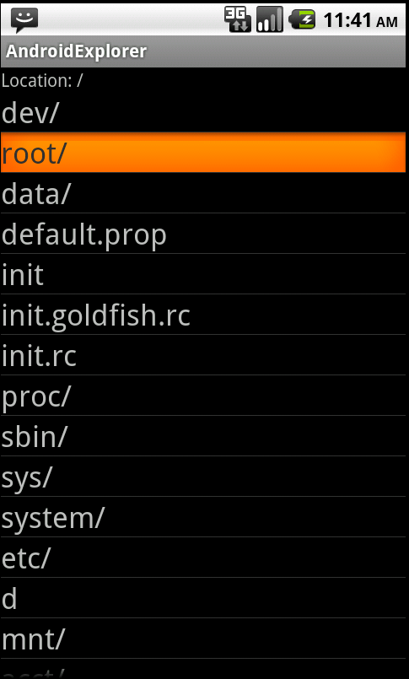
Homework
Create simple File browser using listFiles API

Slide 28
Thank you!

